Slide 1
ES6 PRESENTATION TOPIC : Async / aWAIT
PRESENT BY: SOBIA HAFSA
JAVERIA IMRAN

Slide 2


Slide 3
Async / await
Is a feature in JavaScript that allows you to write asynchronous code in a more synchronous and readable manner. It is built on top of Promises, which are a way to handle asynchronous operations.

Slide 4
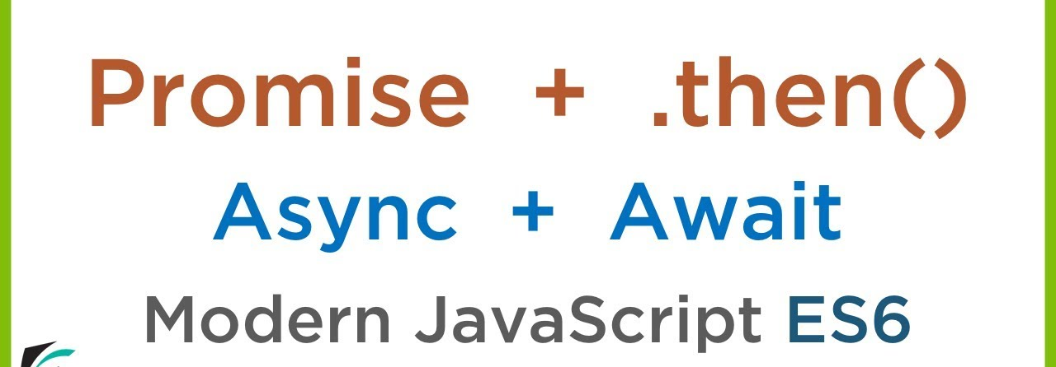
Difference between Async and Await

Slide 5
Async
Definition:
The async keyword is used to declare an asynchronous function. It allows you to define a function that will operate asynchronously and always returns a Promise

Slide 6
Await
Definition:
The await keyword is used inside an async function to pause the execution of the function until a Promise is resolved. It can only be used within an async function.

Slide 7
async function fetchData() {
const response = await fetch('https://jsonplaceholder.typicode.com/posts'); // Pause execution until the fetch operation completes
const data = await response.json(); // Pause execution until the JSON parsing is done return data;
}
fetchData()
.then(data => {
console.log(data);
})
.catch(error => {
console.error(error);
});

Slide 8
async function fetchData() {
try {
const response = await fetch('https://jsonplaceholder.typicode.com/posts');
const data = await
response.json();
return data;
} catch (error) {
console.error(error);
throw new Error('Failed to fetch data');
}
}
fetchData()
.then(data => {
console.log(data);
})
.catch(error => {
console.error(error);
});

